Slide 1
Project presentation 2020-2021

Slide 2

YESHWANTRAO CHAVAN COLLEGE OF ENGINEERING, NAGPUR
(An autonomous institution affiliated to Rashtrasant Tukadoji Maharaj Nagpur University, Nagpur)
DEPARTMENT OF ELECTRONICS ENGINEERING
“SMART SHOPPING CART”
Presented By
ROHIT PATIL
ANIKET BELOKAR
MANISHA ZAMPALKAR
TUSHAR ZILPE
RAUNAK WALDE
Under the guidance of
DR. PRADNYA ZODE
2020-2021

Slide 3
contents:
CONTENTS
Overview
Literature review
Proposed solution
Objectives
Block diagram
Flow diagram
Hardware description
Working
Applications
Result and conclusion
Future scope
References

Slide 4
Overview
A supermarket or a hypermarket is a form where wide variety of product items are available. The main purpose of supermarkets is to provide availability of all the products and save the time of the customers but sometimes customer gets frustrated while waiting in the queue at billing counter and sometimes they get confused while comparing the total price of all the products with the budget in the pocket before billing.
In Shopping markets
The checkout procedure is time consuming because it usually requires a wait in line. Further, the objects often have to be rehandled by the shopper and/or the cashier and the bill total can be error prone.
There are limitations on instructing the shopper of the store layout and the specific locations of items in the store, including objects on sale.

Slide 5
3. It involves a number of steps such as getting in line for a checkout register, presenting the objects to the cashier, totaling the amount of the bill for all the objects, paying the bill, and taking the objects out of the store.
4. The store also has to provide a check out station which requires space for counters and registers that could be used for merchandise.
5. In addition, there is the expense and management of cashiers.

Slide 6
Litrature review
APPLICATION NUMBER 5,729,697
DATE OF FILING Mar. 17, 1998
TITLE OF INVENTION INTELLIGENT SHOPPING CART
The present apparatus is a mobile shopping cart that can automatically keep track of objects selected and carried in the cart and provide a customer using the cart information like the total price of the items carried.
The cart has a radio frequency cart base station with a cart antenna connected to a radio frequency cart transceiver.

Slide 7
APPLICATION NUMBER US 2017/0186072 A1
DATE OF FILING Jun. 29, 2017
TITLE OF INVENTION SMART SHOPPING CART AND METHOD OF USE
The Smart shopping cart may hold a set of containers that the customer can place their items in as they are shopping. The customer will associate their mobile device with the physical cart as an electronic shopping cart.
Disclosed is a Smart shopping cart comprising a mobile device holder; a removable container; an RFID reader, wherein the RFID reader detects items being added or removed from the Smart shopping cart; and a link to an electronic cart on a customer mobile device, wherein the electronic cart is updated as the items are being added or removed from the Smart shopping cart.

Slide 8
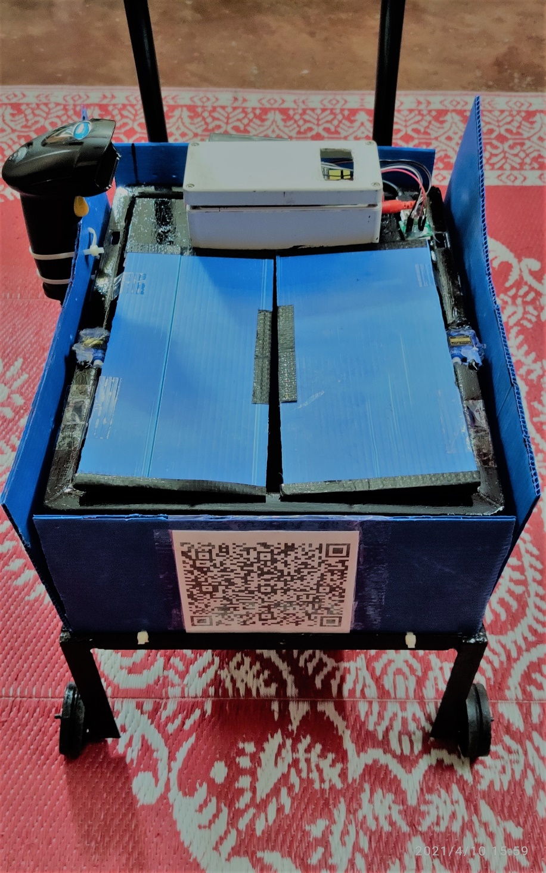
Proposed solution
We need to develop a smart shopping cart with bar-code scanner which will scan every product after dropping it in cart then it will display on screen present on cart and after shopping done with the help of IOT the total bill can be generate on the Mobile application of Customer.
In Smart shopping cart System, now there is no need for the customer to wait in the queue and wait for his/her turn for the scanning of the product items.
It will improve system for shopper object selection and checkout in a store.
It will improve system for shopper guidance and direction while shopping in a store.
It will improve system for providing a running total of a bill during object selection in a Store.
It will also improve the system for eliminating checkout facilities and object handling in stores.
“SMART SHOPPING CART”

Slide 9
Objective
To reduce the time of customer waiting in the queue.
To add self product scanning facility with the help of barcode scanner.
To replace the manpower requirement with technology.
To make payment directly with the help of android app.
To make cart with full of IOT support which will generate bill on customers mobile application.
To make shopping system smart, efficient and fast.

Slide 10
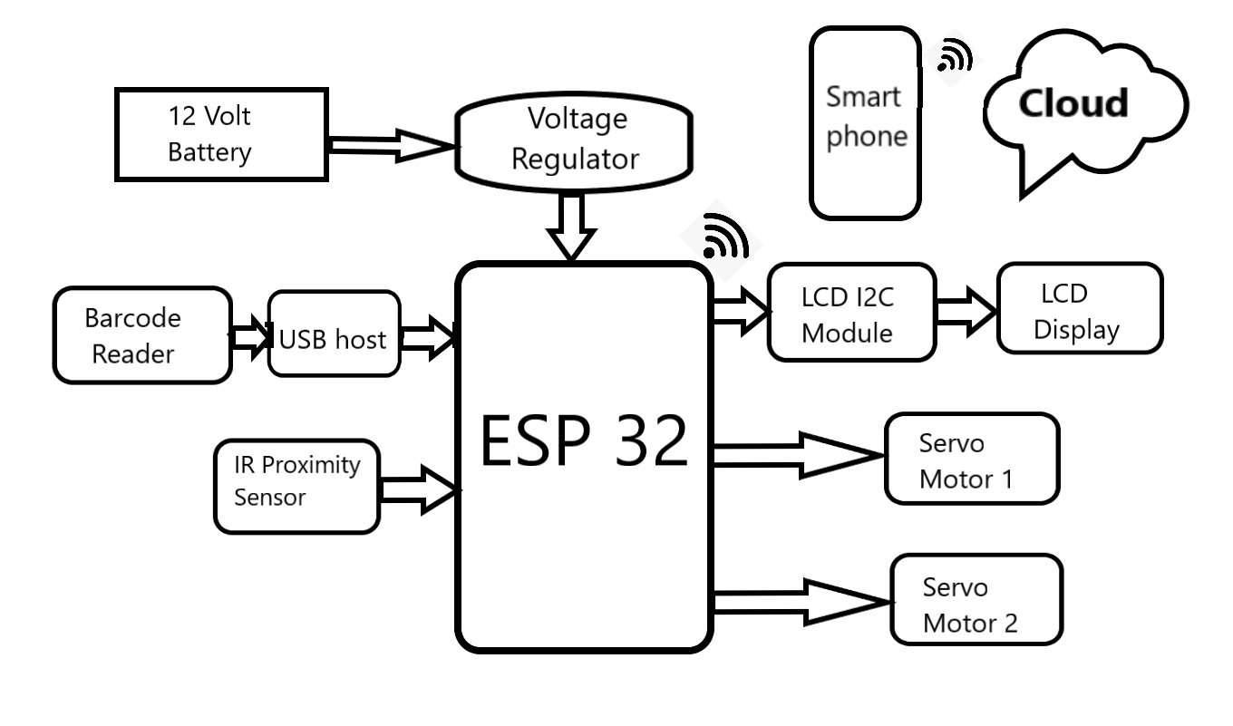
Block diagram

Slide 11
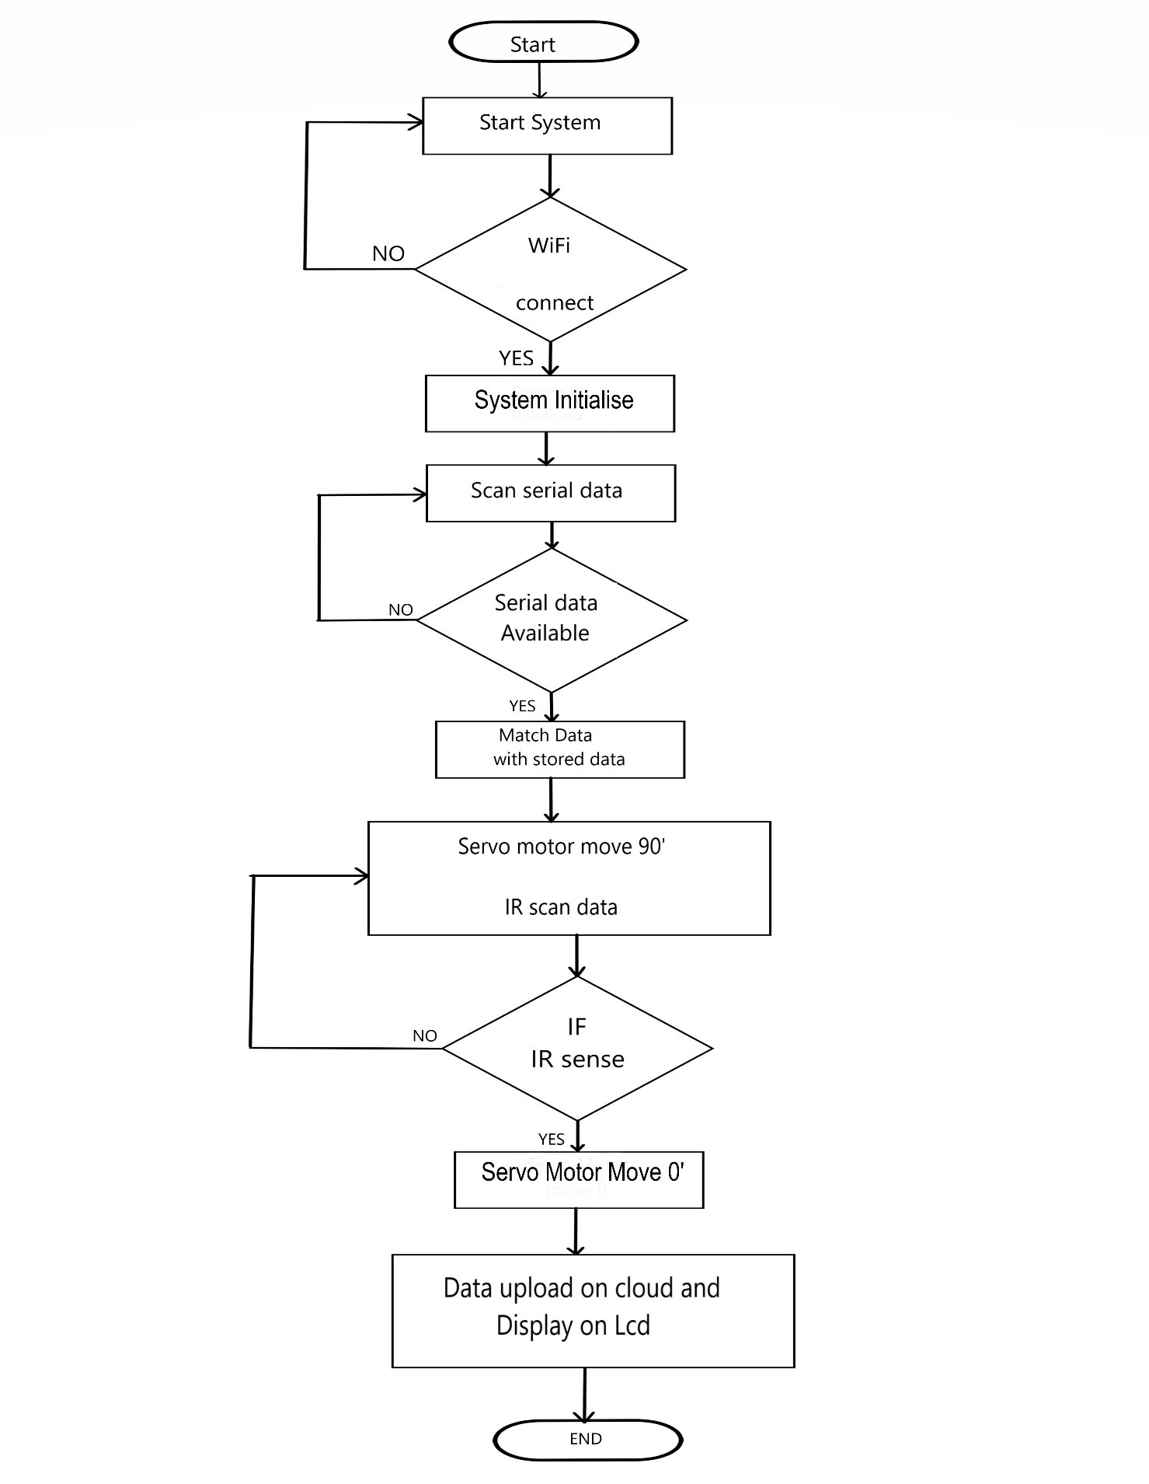
Flow diagram

Slide 12
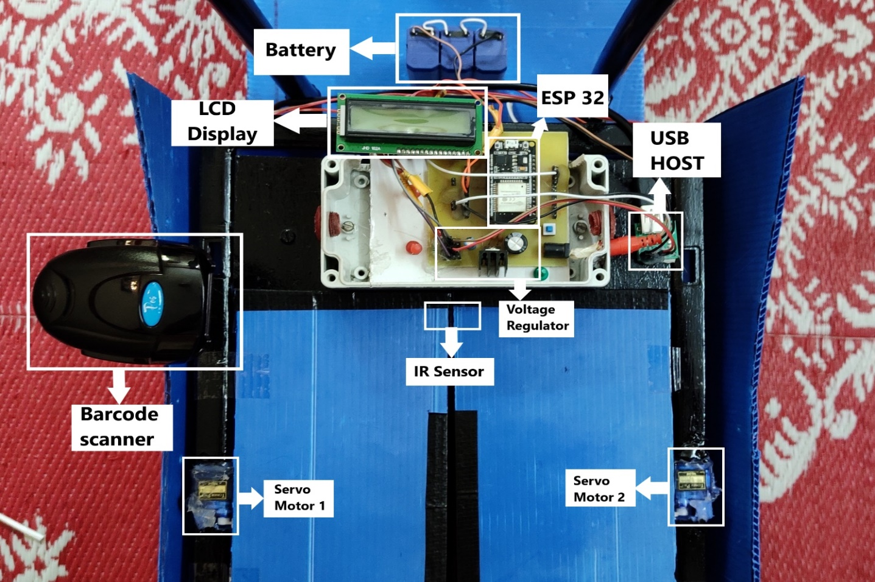
Hardware discription
ESP-32 Board
Barcode Scanner
Barcode scanner-USB Host
IR Sensor
Voltage Regulator
Servo Motor
LCD display
Battery

Slide 13
working
The project is basically used for the Shopping purpose. Customer only needs to scan QR code present on cart by his mobile application then the cart will be activate.
Initially the lid of the cart will be closed, with the help of Barcode scanner present on the cart whenever customer scans every product the lid of cart will be open and after dropping product the lid will close.
Without scanning the lid won’t open. The amount and product drop notification will be seen on LCD screen present on cart.
After Scanning of every product the lid will open and product will be dropped inside the cart. The operation of opening and closing of Lid of cart will be done with the Servo Motors present on both the sides.

Slide 14
With the help of IR sensor present inside it will be sensed that the product is dropped with the dropping movement the lid will be close.
The dropped product will be added to the bill which is simultaneously generating for every product after scanning on mobile application of Customer. This operation will be done with the help IOT.

Slide 15
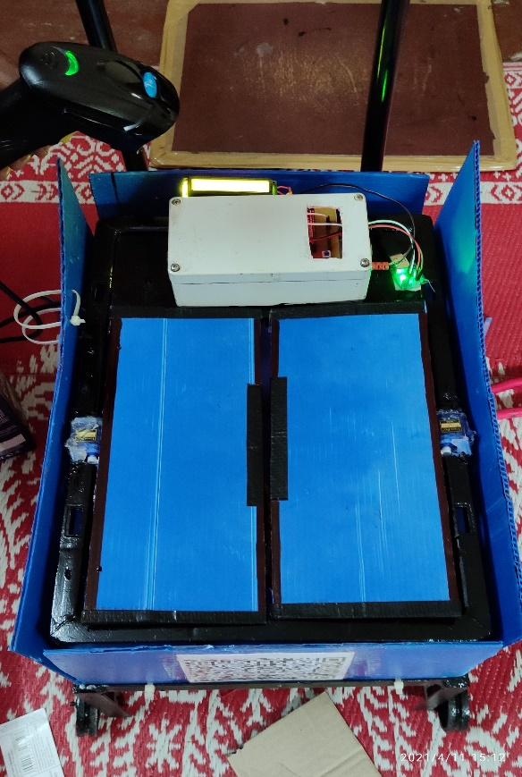
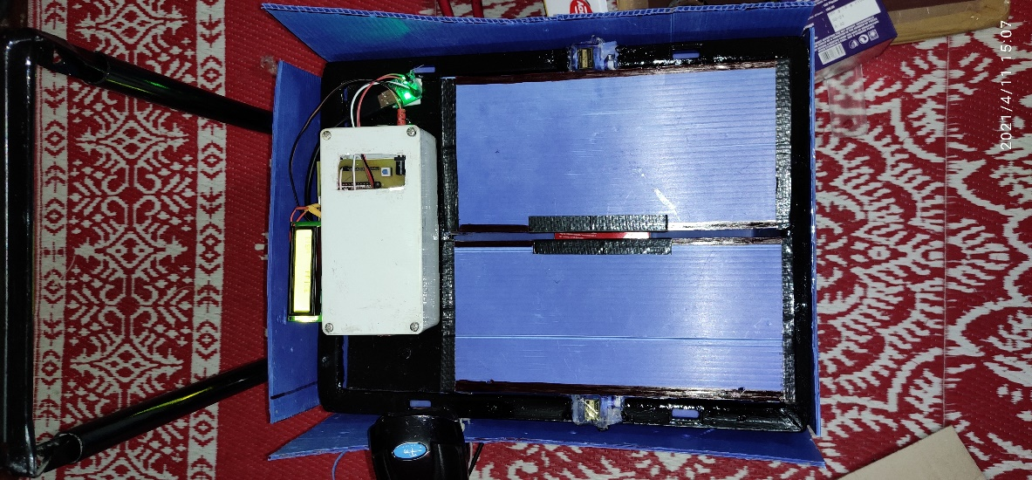
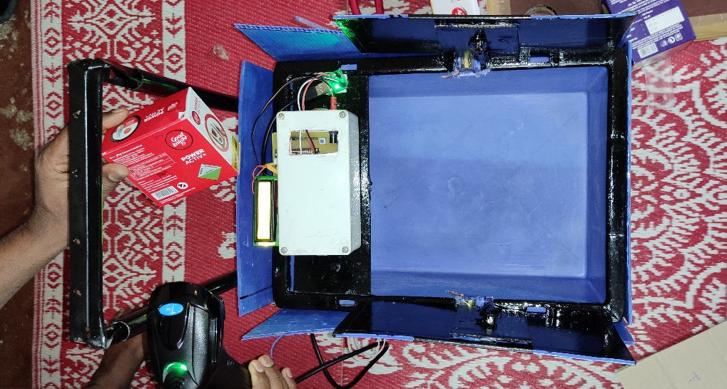
After Scanning the Product
Before Scanning the Product
After Dropping Product

Slide 16
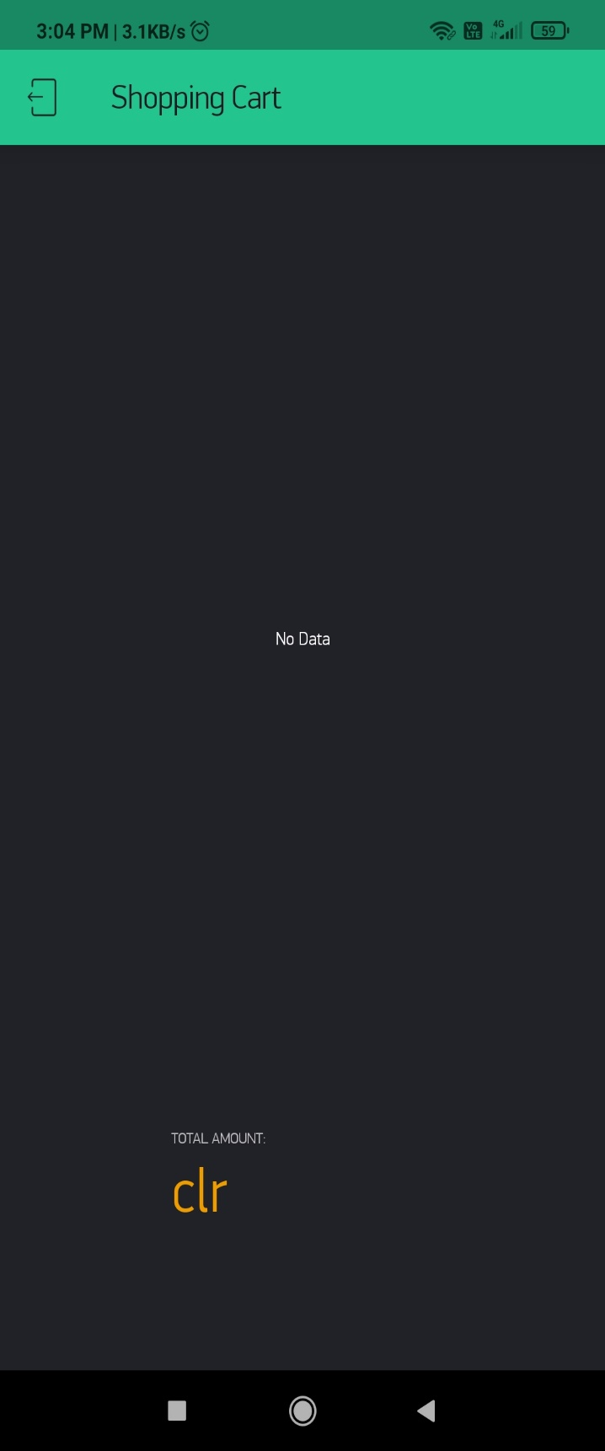
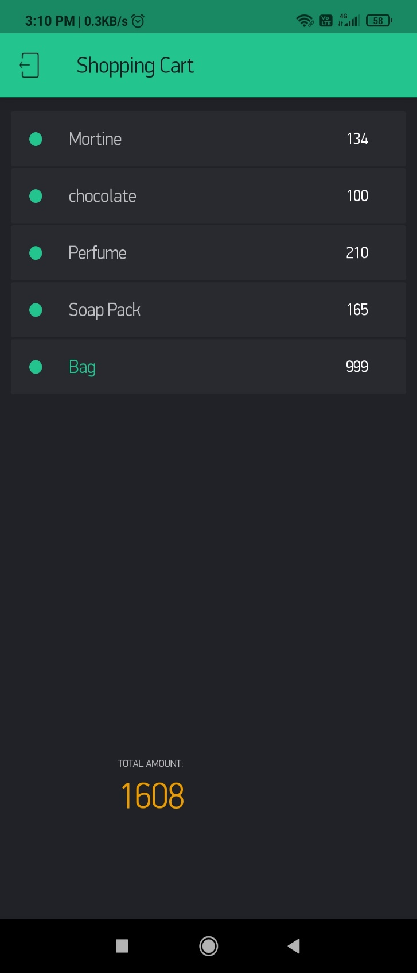
Before Shopping Generated Bill
After Shopping Generated Bill

Slide 17
APPLICATIONS
In Smart shopping cart System, now there is no need for the customer to wait in the queue and wait for his/her turn for the scanning of the product items. Especially during weekends or festivals season, there is not time wastage in waiting in the queue. The customer has to do only billing at the billing counter.
With the help of this invention we will improve system for shopper object selection and checkout in a store.
It will improve system for shopper guidance and direction while shopping in a store
It will improve system for providing a running total of a bill during object selection in a Store.
It will also improve the system for eliminating checkout facilities and object handling in stores.
the Manpower expense can also be reduce with the help of this system.

Slide 18
Result and conclusion
We validated the effectiveness and advantages of our proposed methodology by doing software testing. Each module of the program was verified with various test cases. The device was programmed through ESP-32 efficiently.
The goal of this project was to make Smart Shopping System, now there is no need for the customers to wait in the queue and wait for his/her turn for the scanning of the product items.
The customer has to scan barcode of product before dropping it in the cart and the bill can be generate on his mobile through mobile application.
So, supermarkets or hypermarkets use this concept as their business strategy to attract more number of customers. The future scope is wide as per its use as it stands to be the greatest issue for time being.

Slide 19
FUTURE scope
We have to update the details of the product items in the memory unit of trolley time to time. We take the help of Internet of Things and some software with the help of which all information will be updated regularly.
Also, with the help of optical sensor, motors, and motor drivers, we will make trolley in such a way that it will follow the customer which purchasing items.
Later in future this intelligence system will advice the customer which products can be removed from the basket if the budget exceeds.
We have to find the mechanism to deselect the removed products from billing. So some other technique can be incorporated to increase its efficiency.

Slide 20
references
News paper articles
Mario Schkolnick, San Jose, Calif and Robert Jacob von Gutfeld, New York, ”INTELLIGENT SHOPPING CART” United States, Patent Patent Number: 5,729,697, DATE OF FILING Mar. 17, 1998
Jimmie R. Clark and (US), Richard Andrew White Pineville MO (US) and Christopher Soames Johnson, Pea Ridge, AR (US) ” SMART SHOPPING CART AND METHOD OF USE”, United States Patent Application Publication, Pub. No.: US 2017/0186072 A1, Pub. Date: Jun. 29, 2017
https://www.exploreembedded.com/wiki/Overview_of_ESP32_features._What_do_they_practically_mean%3F – ESP-32
https://www.abr.com/barcode-scanner/ - Bar code scanner
http://www.alselectro.com/barcode-scanner-usb-host.html - USB host
Research design labs, https://researchdesignlab.com, https://researchdesignlab.com/sensors/irobstacle-sensor.html - IR Sensor
78XX https://en.m.wikipedia.org/wiki/78xx - Voltage Regulator
https://circuitdigest.com/article/16x2-lcd-display-module-pinout-datasheet - LCD display
https://en.wikipedia.org/wiki/DC_connector#:~:text=A%20DC%20connector%20(or%20DC,types%20that%20are%20not%20interchangeable.-DC connector
https://circuitdigest.com/article/servo-motor-working-and-basics -Servo motor
https://bisouv.com/uncategorized/4073229/recent-news-stories-shows-how-the-smart-shopping-carts-market-products-are-surviving-in-the-global-industry-to-2026/

Slide 21
THANK YOU

